Slide 1
Corporate QE
Calibration Meeting
Jan 10-14, 2011
Prepared by
Denise Echols

Slide 2
Contents
2010 Good, Bad, Ugly
2010 –In Review
Strategy and Goals
Service Request Calibration
CAR Verification
Metrics in Audits
Culture Discussion
Audit Planning & Scheduling

Slide 3
2010 Good, Bad &Ugly
Good, Bad, & Ugly

Slide 4
2010 - In Review
Strengthen Team
  Continue Good from 2009!
  Cross Training of Lead Auditors
    Lead Auditor Rotation
  CAR Adms → Auditors
  Lead Auditors →CAR Adms
  New Responsibilities
    Kai (Corp QE Trainer - new systems)
    Tovia/Mel (Trainers- new auditor training program)
    Mel (Auditor Monitoring/Review)
Customer Support
  Increase face/face or telecon interaction vs. email
  CAR and CAR Metrics Review → Customer Notification
    Department Meetings Interface
  Continue support via teams (eg Lab Doc Enhancement)
Great Job!
Saw evidence of this

Slide 5
2010 - In Review
Web Site
    Metrics
      Metrics on-line via web
      CAPA input/support
    Combine IQA/CAR Websites
      Easier Navigation
      Corporate look
CAR Process/Tool
    Review Process
      Business Needs/Company Direction
      CAPA in mind
    Tool
      Currently available
      Linkage other systems
We did it!
Great effort; lots of work; have inputs!
However..NO TOOL IN 2011!

Slide 6
2010 – In Review
Effectiveness Audits
    Still need compliance audits
    Utilize company metrics, green belt training
      “So What’s ” to CARs (tailored to auditee/situation)
        (eg. Number of customer complaints about test errors has increased over the past 2 years. As a result, customer satisfaction/loyalty could be diminished.
or
        This could be an indication of ineffective staff training.
        Not across all audits/sites/programs/functions
        Controlled introduction → not broadcasted
Might still be able to do ??—company overall not ready- Economy front & center right now!

Slide 7









Corp QE Strategy
2009
2010
2011
2012 ??
On-hold until??
QE Team
Strengthen Team
Revamped Process/Tool
Revamped Process/Tool
IQA Web on Oracle; Updates CAR Web
Customer Support
Effectiveness Audits- maybe a little
using metrics
CAR Metrics on Web; Combined IQA/CAR Db
CAR Process/ New Tool
Strengthen Team
Training Effectiveness Audits
Customer Support
CAR Tool
2011 GOAL
Continue Team Development and Customer Support

Slide 8
Corp QE Strategy
2011
Strengthen Team
  Continue Good from 2010!
  Cross Training of Lead Auditors
    Lead Auditor Rotation
  CAR Adms → Auditors
  Lead Auditors →CAR Adms
  Green Belt Training
  New Corporate Audit members
    Michelle Lee ( supported audits in 2010), Jim Kurtz
    Cheryl, Bill, Mark
Customer Support
  Increase face/face or telecon interaction vs. email
  CAR and CAR Metrics Review → Customer Notification
    Continue support via teams (eg Lab Doc Enhancement)

Slide 9
Corp QE Goals 2011 (Draft rev 2)
1. CARs pending Administrator action processed within CAR SOP time requirements
Targets (per 100 CARs):
Exceeds Requirements: 0 CARs past due stated timeframe
Meets Requirements: <3 CARs past due stated timeframe
Needs Improvement: >3 CARs past due stated timeframe
2. Review CARs to ensure effective root cause and corrective action
Measured by number of CARs moved back from “Closed Awaiting Verification” state because root cause and corrective action response accepted was not effective responses.
Targets (per 100 CARs):
Exceeds Requirements: 0 CARs moved back
Meets Requirements: <3 CARs moved back
Needs Improvement: >3 CARs moved back
3. Training (Revised)
Complete all mandatory training including those who are in training for CAR Administration or Auditing)
Successfully complete the mentoring phase of CAR Administrator training and begin administering CARs independently
Successfully complete the auditing phase of the Auditor training
Targets:
Exceeds Requirements: > 40 hours completed including successful completion of any mandatory training
Meets Requirements: successful completion of any mandatory training
Needs Improvement: not successfully completing any mandatory training
4a. Internal Auditing(Lead Auditors)
Completion of audits and audit documentation as required by SOPs.
Targets:
Meets Requirements: Audits completed as scheduled. Audit reports/findings submitted within 5 days of audit completion. CARs submitted to GCAR at audit closure. All documentation is clear, error free and complete. CARs verified such that no findings are in the closed awaiting verification state longer than 6 months and all observation CARs are closed verified effective at time of last milestone closure.
Needs Improvement: > one late report/scope letter or > three late CAR verifications
4b.Internal Auditing( Auditors)
Completion of assigned audit/CAR activity as assigned by lead auditors.
Meets Requirements: Audit reports/findings and CARs submitted as required by lead auditor. Documentation is clear, error free and complete. CARs verified such that no findings are in the closed awaiting verification state longer than 6 months and all observation CARs are closed verified effective at time of last milestone closure.
Needs Improvement( per 100 CARs) : > one late report or audit documentation or > three late CAR verifications
5. Individual specific goal.

Slide 10
Corp QE Goals 2011
Chris (Draft)
Keep sites maintained to support QE (GCAR & IQA) Activity
Targets: Exceeds Requirements: 0 errors issues with sites
Meets Requirements: <3 errors per site no - impact on users
Needs Improvement: >3 errors per page site that has impact on users
2. Complete any site/tool change or upgrade per time frame scheduled
Target: Exceeds Requirements: completion ahead of schedule with no errors
Meets Requirements: on-time completion with < 3errors; no impact to users
Needs Improvement: >1 schedule miss for items within your control
3. Training (Revised)
Complete all mandatory training
Targets:
Exceeds Requirements: > 40 hours completed including successful completion of any mandatory training
Meets Requirements: successful completion of any mandatory training
Needs Improvement: not successfully completing any mandatory training
4. Respond to customers & QE’s within 24 hours
Target:
Meets Requirements: Response with 24 hours
Needs Improvement: responses > 24 hours
5. Individual specific goal.

Slide 11
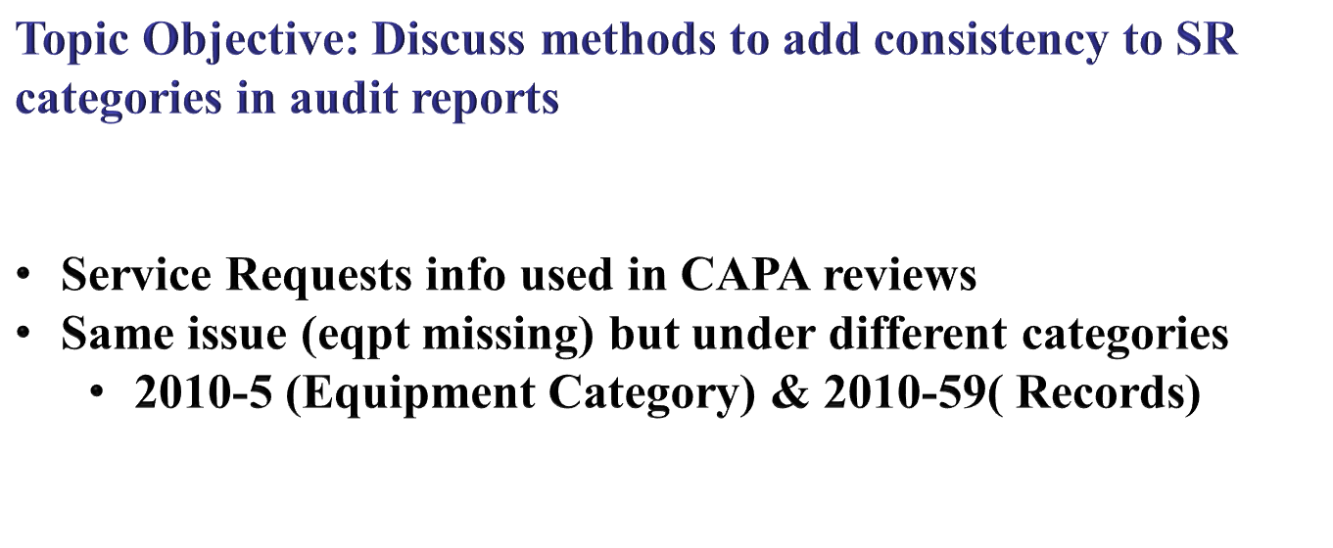
Service Request Calibration

Slide 12
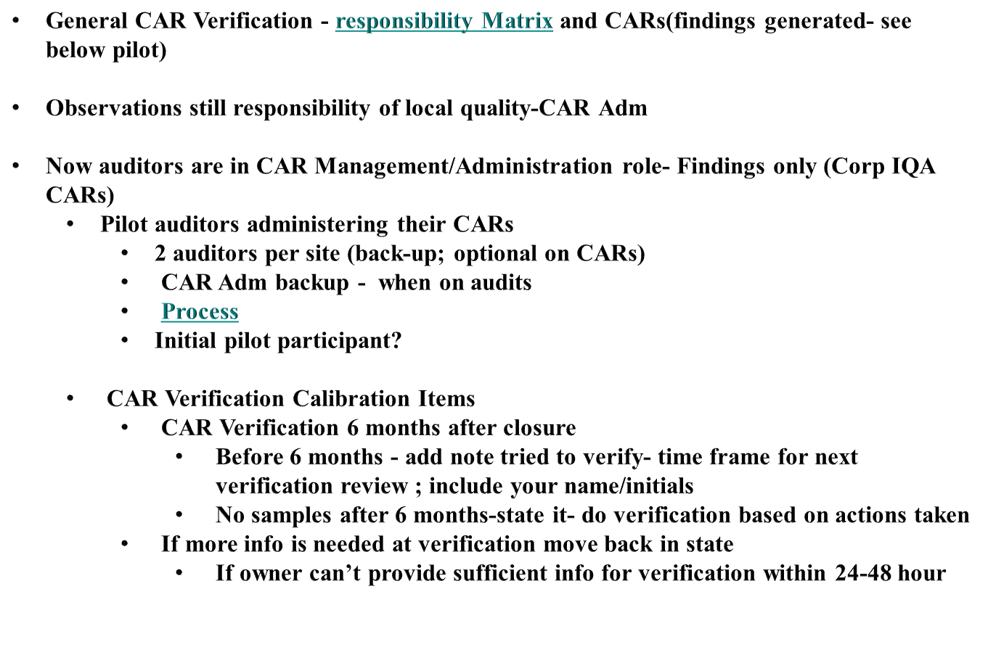
CAR Verification
Topic Objective: Discuss CAR verification roles, CAR back-up requirements, responsibilities, time frames…..

Slide 13
Metrics in Audits
Topic Objective: Discussion on use of metrics for effectiveness
Effectiveness Audits
  Effectiveness audits are a key management tool for improvement
  Impacts to conducting
    Company Maturity
    QMS Implementation
    Economy
  2011 Audits can do a little effectiveness
    Customer Complaint requires review of metrics…
    Process/Program Owners repeating CAR issues…
      Word of caution…some known issues like datasheets
      Staff/manager awareness…let’s not tell!
    Not full scope of an audit

Slide 14
Culture Discussion
Topic Objective: Discussion that may help in working with individuals or teams
Information in general….
  May seem like stereotypes
    Don’t assume all in culture as described

Slide 15
2011 Audit Planning
General Stuff
  Budget Constraints
    Double up auditors on site audits
      Reduce time on site and reduce number overall trips; weekend stays, etc
      Supports team development and transition of auditors
      More review of expense reports
    Group audit visits to reduce travel
    Constraints on rescheduling
        Reduce Dec audits. Nothing after 1st week of Dec
        Start looking at ISO 17065 rules- audit in a calendar year
    Lunch should be on-site cafeteria or box lunch
        Help support budget constraints
        Reduce on-site audit time

Slide 16

2011 Audit Planning
Auditor Roles
  Lead Auditor – Responsibility for successful outcome
    Manage the audit and team……
      Set schedules with team
      Assigns audit paths
      Ensures audit documentation on web
      Interfaces with auditee
      Reviews CARs (duplication, valid, combine) & ensures input into GCAR
      Consolidates Reports/pathnotes
      Notifies DLE of any issues
    Auditors -Responsibility for supporting successful outcome
      Adheres to time schedules as set
      Completes tasks as assigned – on time
      Works with lead auditor on issues or concerns
  No Team Disagreements in front of Auditees!

Slide 17
2011 Audit Planning
Auditor Assignments
Region&associated Programs & Processes | Lead Auditor | Auditor
Europe | Alan | Mel
Asia | Kai | Jim C
US East | Jim C | Jim K
US West | Mel | Julie& Michelle
US Central | Tovia | Alan, Cheryl, Bill, Mark, Jim K
Canada | Kai &Jim C | Kai & Jim C
Latin America | Alan | Tovia
FUS desk | Jim C | Julie
FUS @sites | All auditors
Customer Complaints | All auditors
Customer Complaints | NBK audit to include Corporate
RTC | All auditors
HR | All auditors
Technical Competency | All auditors
Document Control | All auditors
 | NBK audit to include Corporate

Slide 18
2011 Audit Planning
Stakeholder inputs
  Lead Auditors review info for 2011 scopes
Document Changes requiring audits
  Global Lab policies/SOP- many changes
    Need doc audit in January to ensure meeting ISO 17025
      Kai (lead) &Mel &others
      Feedback needs to be given to all lead auditors as input to 2011 lab audits (some items to be reviewed on site)
        Concern- Proficiency test sites maintain corrective action (CA process meet ISO 17025?)
  Combined Audits
    2011 schedule has some updates already identified –incorporated
    Additional info??
  Sites set for no annual site visit
    Iberica, San Diego, Thailand, Sweden…others?
  Site Accreditations(A2LA, IAS, etc)
      QE Web has info
      Include in scope
      Template update

